Slide 1
Bank Loan Analysis Project

Slide 2
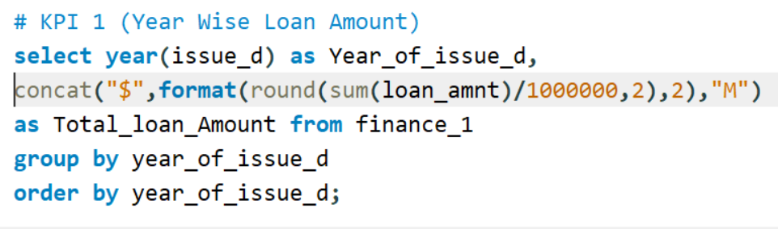
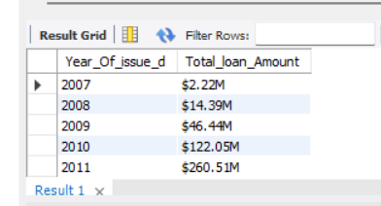
Year-wise Loan Amount

Slide 3
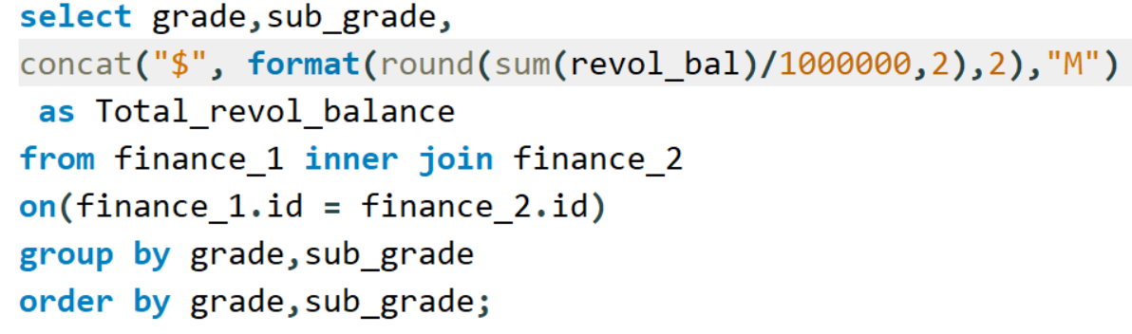
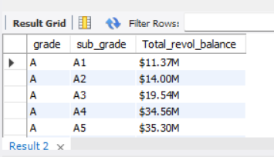
Grade & Sub-grade Revolving Balance

Slide 4
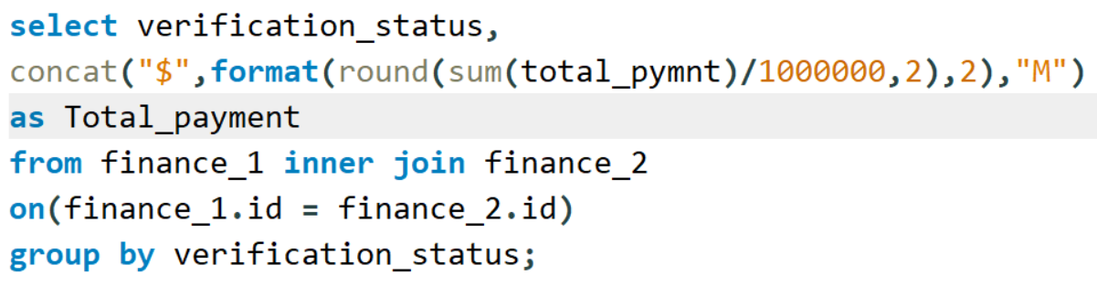
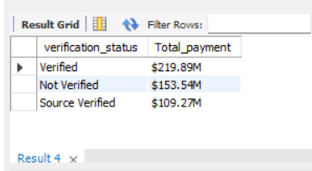
Verified vs Non-Verified Payments

Slide 5
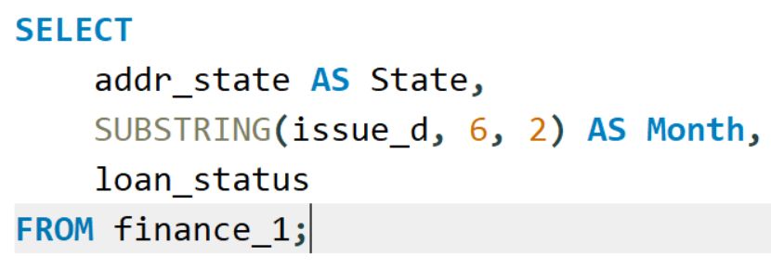
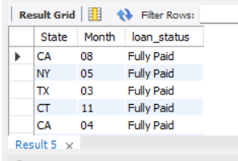
State & Month-wise Loan Status

Slide 6
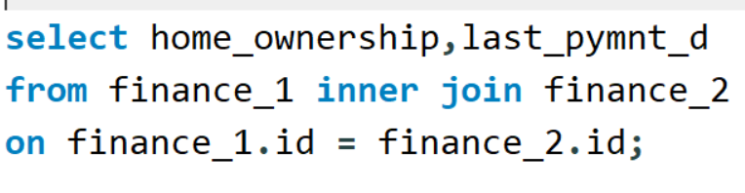
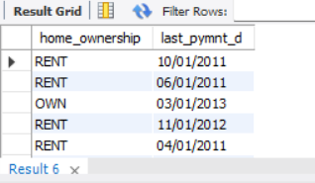
Home Ownership vs Last Payment

Slide 7
Recommendation
Verified borrowers show better repayment behavior
Some grades carry higher risk due to high revolving balance
Loan repayment differs across states → needs closer monitoring
Home ownership type affects repayment consistency
Banks should continue using KPI-based analysis for smarter decisions

Slide 8
THANK YOU

